Slide 1
Network Presence
CEH Test Prep Video Series

Slide 2
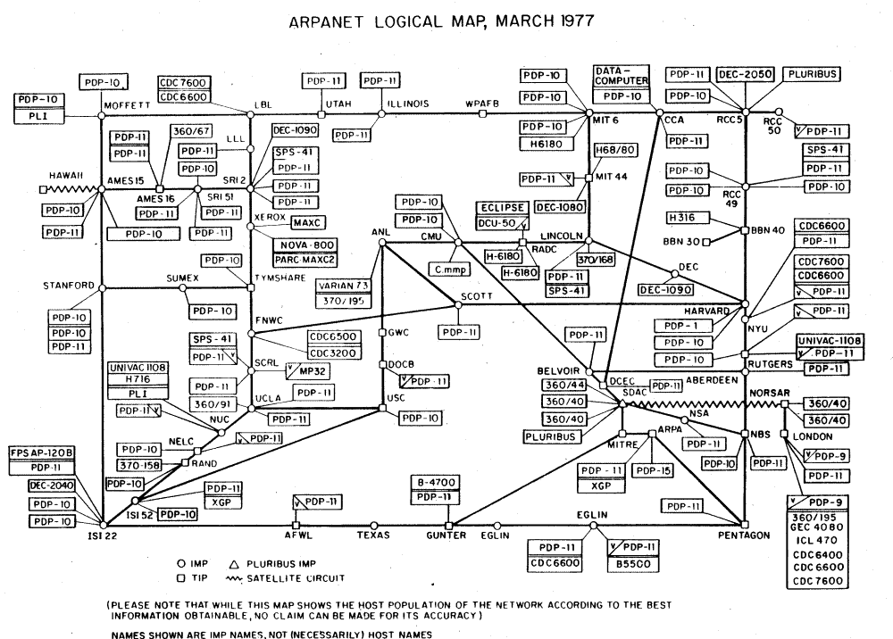
Network insecurity

Slide 3
Sniffing & Spoofing
Sniffing
Passively or actively capturing network traffic
Can be done on received traffic or passed through/routed traffic
Can be done anywhere on the internet
Routers/gateways are more risky
Mitigated by SSL/TLS or other E2E crypto
Spoofing
Actively tampering with other hosts network config to `intercept` network traffic
Then, sniffing or tampering with intercepted traffic
Very common in LAN
Port security, traffic signing, SSL/TLS are possible means of protection

Slide 4
Sniffing tools
Wireshark
Actively sniffing and analyzing
Processing external pcap files
Powerful GUI
Extendable and scriptable
Really slow sometimes
Security issues
Cain & Abel
Windows only
Spoof, sniff, reverse passwords etc.
tcpdump (or other CLI tools)
The power of console
Present in most *NIX distros
tshark
Console version of Wireshark
Comes with it by default
scapy
BYOD: build your own dump
Easy as Python + StackOverflow ☺

Slide 5
Spoofing tools
arpspoof
arpspoof -t <target>
arpspoof -t <gateway>
tcpdump
Remember to enable forwarding:
# echo 1 > /proc/sys/net/ipv4/ip_forward
ettercap & bettercap
Scanning, spoofing, and sniffing

Slide 6
Crypto & WiFi considerations
Intercepting encrypted traffic
SSL/TLS
SSLStrip+
Burp Proxy, OWASP ZAP etc.
Strong E2E crypto
WiFi spoofing and sniffing
Hardware tools
Packet injection
Alfa
Software tools
aircrack-ng – universal framework
Mana – rogue AP toolkit
Kali tools

Slide 7
References
Tools
Wireshark https://www.wireshark.org
Scapy http://www.secdev.org/projects/scapy/
Bettercap https://www.bettercap.org
Reading
Packet Sniffing and Spoofing Lab http://www.cis.syr.edu/~wedu/seed/Labs_12.04/Networking/Sniffing_Spoofing/Sniffing_Spoofing.pdf

